Slide 1
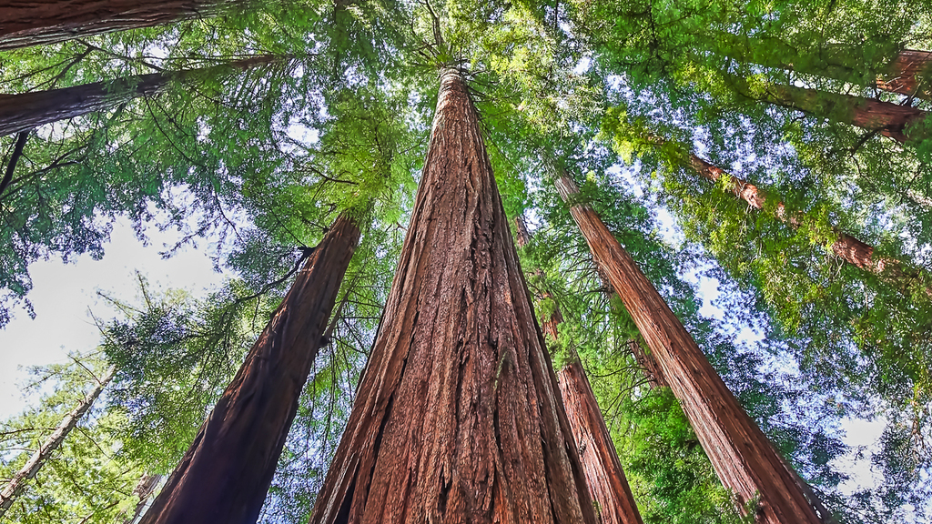

Lambda++

Slide 2

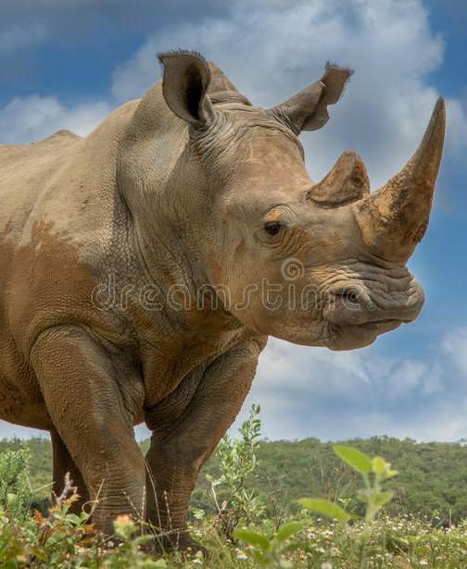
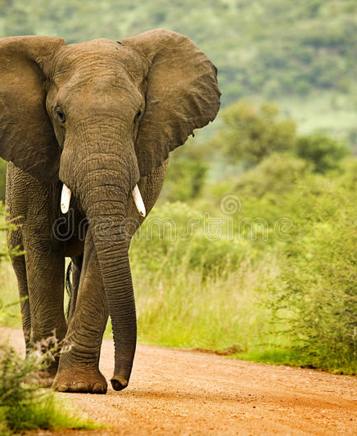
Introduction
Conservation of elephants and rhinos
ERP, EPI-USE and GroupElephant.com
Supporting local communities
What's the problem?

Slide 3

Only one administrator
No single, dedicated system
Manual tracking of employees and stock
Problem Statement

Slide 4
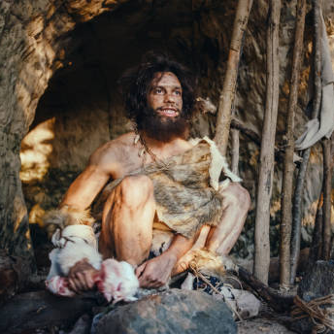
Current Systems in Place
Use of systems like WhatsApp, Excel & Word
Data collection is tedious and time consuming
Ineffective tracking of tasks

Slide 5

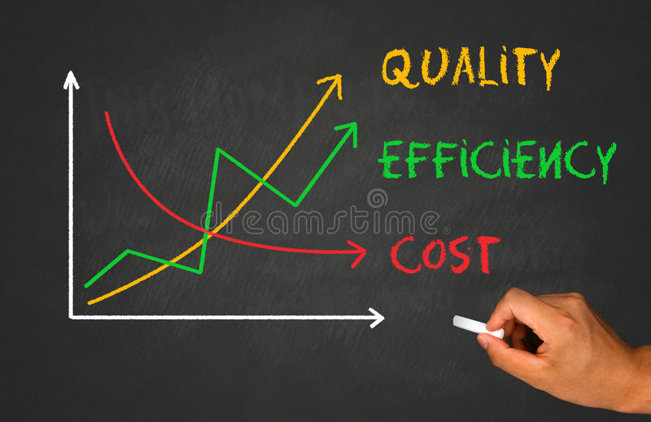
Administrator site
Mobile application for employees
Up to date decision making
Eliminate stock issues
Problem Solution

